Slide 1
INLA formula for subnational U5MR (>5 areas)
Y ~ offset(logoffset) +
age.intercept - 1 +
time.slope.group1 + time.slope.group2 + time.slope.group3 + time.slope.group4 + time.slope.group5 + time.slope.group6 +
f(survey.id, model = "iid", extraconstr = list(A = survey.A, e = survey.e), hyper = list(theta= list(initial=log(0.001), fixed = TRUE))) +
f(time.struct, model = "ar", order = ar, hyper = hyperar1, constr = TRUE, extraconstr = NULL, values = 1:N, replicate = age.rep.idx) +
f(time.unstruct, model = "iid", hyper = hyperpc1, values = 1:N) +
f(region.struct, graph = Amat, model = "bym2", hyper = hyperpc2, scale.model = TRUE, adjust.for.con.comp = TRUE) +
f(region.int, model = "besag", hyper = hyperpc1.interact, graph = Amat, group = time.int, control.group = list(model = "ar", order = st.ar, hyper = hyperar2), scale.model = TRUE, adjust.for.con.comp = TRUE) +
f(st.slope.id, st.slope, model = "iid", hyper = hyperpc.slope)

Slide 2


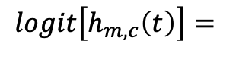



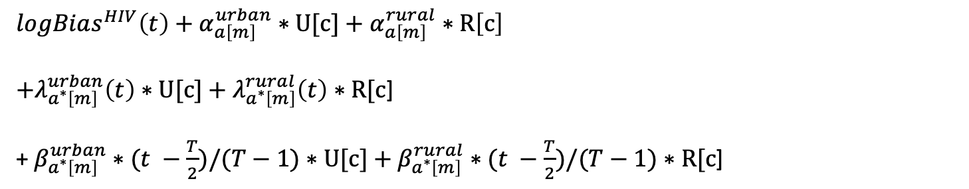
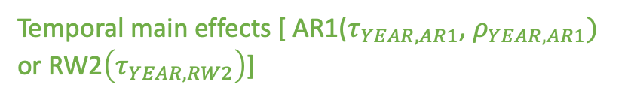
Model for subnational U5MR (>5 areas)
where
a denotes one of 6 age groups
m denotes month
c denotes cluster
t denotes year
a* denotes one of 3 age bands
T denotes total number of years
$$Y_{a,c}\left(t\right)| h_{m,c}\left(t\right)\sim BetaBinomial(n_{m,c}\left(t\right), h_{m,c}\left(t\right), d)$$
$logBias^{HIV}\left(t\right)+α_{a\left[m\right]}^{urban}∗U[c]$ $+ α_{a\left[m\right]}^{rural}∗R\left[c\right]$
$+λ_{a^{∗}\left[m\right]}^{urban}\left(t\right)∗U[c]+λ_{a^{∗}\left[m\right]}^{rural}\left(t\right)$ $∗R[c$]
+ $β_{a^{∗}\left[m\right]}^{urban}∗(t −\frac{T}{2})/(T−1)∗U[c]+β_{a^{∗}\left[m\right]}^{rural}∗(t −\frac{T}{2})/(T−1)∗R[c$]
$$logit\left[h_{m,c}\left(t\right)\right]=$$
Intercepts
Temporal main effects [ AR1($τ_{YEAR,AR1}$, $ρ_{YEAR,AR1})$
or RW2$\left(τ_{YEAR,RW2}\right)$]
Temporal main linear trend (only if AR1 is used)
$${+ β}_{k}$$
Fixed survey effect with sum to zero constraint
$$+ ε(t)$$
IID random effect in year t: $N(0,1/τ_{YEAR,IID}$)
$$+ S_{i[c]}$$
Spatial term for area i, containing cluster c: BYM2($τ_{AREA}, φ_{AREA})$
$$+ δ_{i\left[c\right]}(t)$$
Interaction term for year t, area i, containing cluster c: ICAR-AR1($τ_{AREA,INT}, ρ_{YEAR,INT})$
$+ η_{i\left[c\right]} ∗(t −\frac{T}{2})/(T−1)$
IID random area-level slope: $N(0, 1/τ_{INT,IID}$) (only included if interaction is AR1)

Slide 3
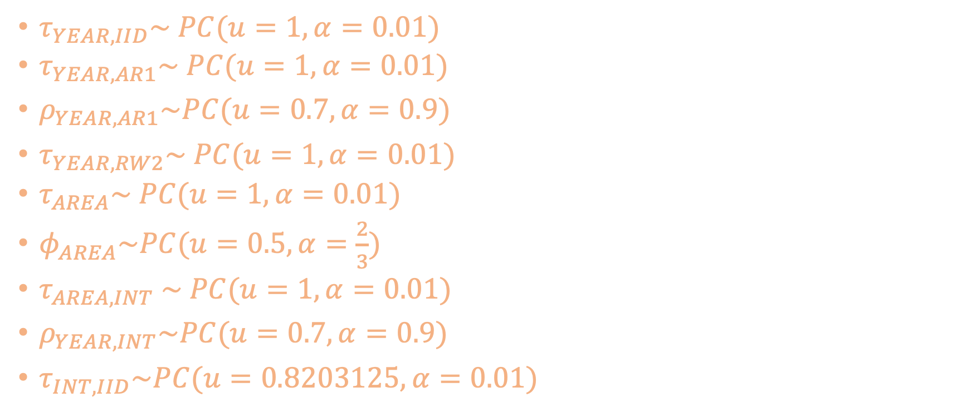
Hyperpriors
$τ_{YEAR,IID}\sim PC(u=1, α=0.01)$
$τ_{YEAR,AR1}\sim PC(u=1, α=0.01)$
$ρ_{YEAR,AR1}\sim PC(u=0.7, α=0.9)$
$τ_{YEAR,RW2}\sim PC(u=1, α=0.01)$
$τ_{AREA}\sim$ $PC(u=1, α=0.01)$
$φ_{AREA}\sim PC(u=0.5, α=\frac{2}{3})$
$τ_{AREA,INT}$ $\sim PC(u=1, α=0.01)$
$ρ_{YEAR,INT}\sim PC(u=0.7, α=0.9)$
$τ_{INT,IID}\sim PC(u=0.8203125, α=0.01)$

Slide 4

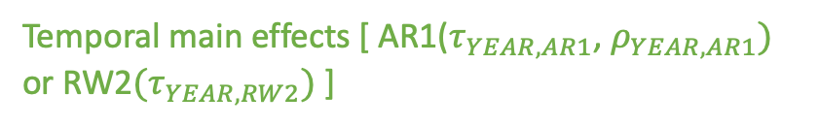
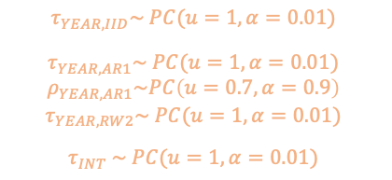
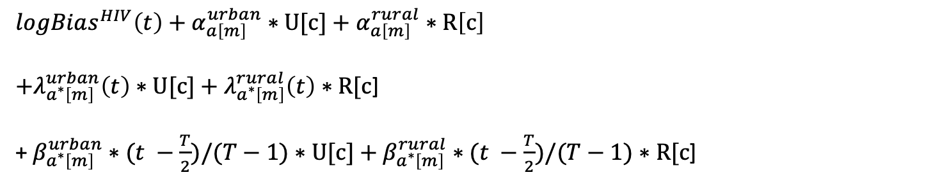
Model for subnational U5MR (<= 5 areas)
where
a denotes one of 6 age groups
m denotes month
c denotes cluster
t denotes year
a* denotes one of 3 age bands
T denotes total number of years
$$Y_{a,c}\left(t\right)| h_{m,c}\left(t\right)\sim BetaBinomial(n_{m,c}\left(t\right), h_{m,c}\left(t\right), d)$$
$logBias^{HIV}\left(t\right)+α_{a\left[m\right]}^{urban}∗U[c]$ $+ α_{a\left[m\right]}^{rural}∗R\left[c\right]$
$+λ_{a^{∗}\left[m\right]}^{urban}\left(t\right)∗U[c]+λ_{a^{∗}\left[m\right]}^{rural}\left(t\right)$ $∗R[c$]
+ $β_{a^{∗}\left[m\right]}^{urban}∗(t −\frac{T}{2})/(T−1)∗U[c]+β_{a^{∗}\left[m\right]}^{rural}∗(t −\frac{T}{2})/(T−1)∗R[c$]
$$logit\left[h_{m,c}\left(t\right)\right]=$$
Intercepts
Temporal main effects [ AR1($τ_{YEAR,AR1}$, $ρ_{YEAR,AR1})$
or RW2$(τ_{YEAR,RW2})$ ]
Temporal main linear trend (only if AR1 is used)
$${+ β}_{k}$$
Fixed survey effect with sum to zero constraint
$$+ ε(t)$$
IID random effect in year t: $N(0,1/τ_{YEAR,IID}$)
$$+ s_{i[c]}$$
Fixed spatial effect for area i, containing cluster c, with sum to 0 constraint
$$+ δ_{i\left[c\right]}(t)$$
IID random effect interaction term for year t, area i, containing cluster c: N($0,1/τ_{INT})$
$τ_{YEAR,IID}\sim PC(u=1, α=0.01)$
$τ_{YEAR,AR1}\sim PC(u=1, α=0.01)$
$$ρ_{YEAR,AR1}\sim PC\left(u=0.7, α=0.9\right)$$
$$τ_{YEAR,RW2}\sim PC(u=1, α=0.01)$$
$τ_{INT}$ $\sim PC(u=1, α=0.01)$

Slide 5

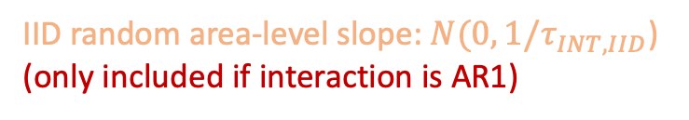





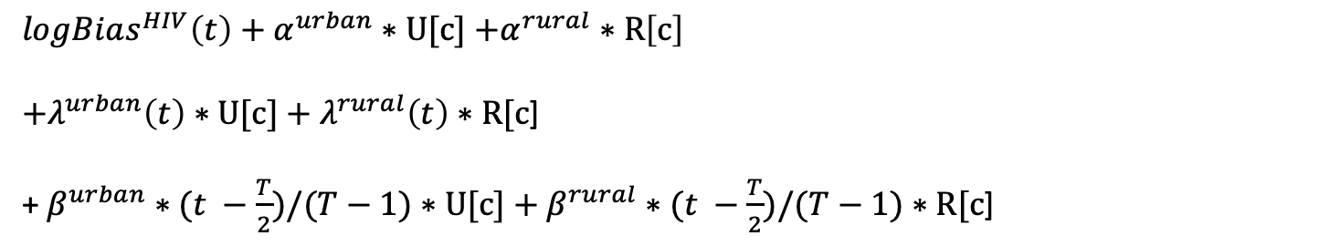
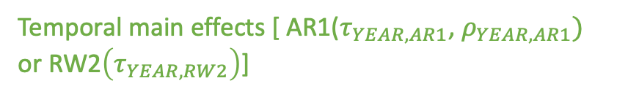
Model for subnational NMR (>5 areas)
where
c denotes cluster
t denotes year
T denotes total number of years
$$Y_{c}\left(t\right)| h_{c}\left(t\right)\sim BetaBinomial(n_{c}\left(t\right), h_{c}\left(t\right), d)$$
$$logit\left[h_{c}\left(t\right)\right]=$$
$logBias^{HIV}\left(t\right)+α^{urban}∗U[c]$ $+α^{rural}∗R\left[c\right]$
$+λ_{ }^{urban}\left(t\right)∗U[c]+λ_{ }^{rural}\left(t\right)$ $∗R[c$]
+ $β_{ }^{urban}∗(t −\frac{T}{2})/(T−1)∗U[c]+β_{ }^{rural}∗(t −\frac{T}{2})/(T−1)∗R[c$]
Intercepts
Temporal main effects [ AR1($τ_{YEAR,AR1}$, $ρ_{YEAR,AR1})$
or RW2$\left(τ_{YEAR,RW2}\right)$]
Temporal main linear trend (only if AR1 is used)
$${+ β}_{k}$$
Fixed survey effect with sum to zero constraint
$$+ ε(t)$$
IID random effect in year t: $N(0,1/τ_{YEAR,IID}$)
$$+ S_{i[c]}$$
Spatial term for area i, containing cluster c: BYM2($τ_{AREA}, φ_{AREA})$
$$+ δ_{i\left[c\right]}(t)$$
Interaction term for year t, area i, containing cluster c: ICAR-AR1($τ_{AREA,INT}, ρ_{YEAR,INT})$
$+ η_{i\left[c\right]} ∗(t −\frac{T}{2})/(T−1)$
IID random area-level slope: $N(0, 1/τ_{INT,IID}$)
(only included if interaction is AR1)
(same hyperpriors as U5MR)

Slide 6


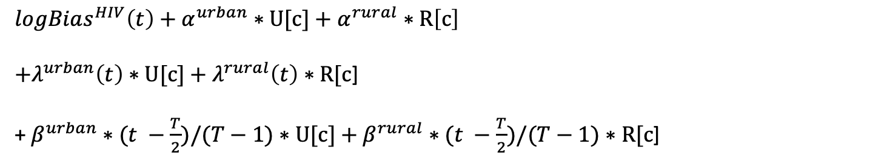
Model for subnational NMR (<= 5 areas)
where
c denotes cluster
t denotes year
T denotes total number of years
$$Y_{c}\left(t\right)| h_{c}\left(t\right)\sim BetaBinomial(n_{c}\left(t\right), h_{c}\left(t\right), d)$$
$logBias^{HIV}\left(t\right)+α_{ }^{urban}∗U[c]$ $+ α_{ }^{rural}∗R\left[c\right]$
$+λ_{ }^{urban}\left(t\right)∗U[c]+λ_{ }^{rural}\left(t\right)$ $∗R[c$]
+ $β_{ }^{urban}∗(t −\frac{T}{2})/(T−1)∗U[c]+β_{ }^{rural}∗(t −\frac{T}{2})/(T−1)∗R[c$]
$$logit\left[h_{c}\left(t\right)\right]=$$
Intercepts
Temporal main effects [ AR1($τ_{YEAR,AR1}$, $ρ_{YEAR,AR1})$
or RW2$(τ_{YEAR,RW2})$ ]
Temporal main linear trend (only if AR1 is used)
$${+ β}_{k}$$
Fixed survey effect with sum to zero constraint
$$+ ε(t)$$
IID random effect in year t: $N(0,1/τ_{YEAR,IID}$)
$$+ s_{i[c]}$$
Fixed spatial effect for area i, containing cluster c, with sum to 0 constraint
$$+ δ_{i\left[c\right]}(t)$$
IID random effect interaction term for year t, area i, containing cluster c: N($0,1/τ_{INT})$
$$(same hyperpriors as U5MR)$$

